Slide 1
Outline
Basics
Circuit Symbol
Construction of Op-Amp
Op-Amp Internal Circuit
Characteristics
Types
Salient Features
Virtual Ground Concept
Op-Amp Circuits
Other functions and applications
Advantages
1

Slide 2
Basics
Operational Amplifier - Also Known as Op-Amp
It is an Integrated Circuit (IC)
Function: Linear, Non-linear and mathematical operations
Circuit symbol of an op-amp.
Capable of handling both AC & DC
2

Slide 3
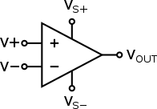
Op-Amp Circuit Symbol
3

Slide 4
Op-Amp Construction
It consists of differential amplifier, level translator and o/p stage.
input stage of op-amp consists of differential amplifier - hence two-input terminals.
input 1 called as Inverting terminal
input 2 called as Non-inverting terminal
Naming convention: the phase relationship between their i/p's & o/p's
4

Slide 5
Characteristics of Op -Amp
Open Loop Voltage Gain
Output offset Voltage
Common Mode Rejection Ratio
Slew Rate
5

Slide 6
Open Loop Voltage Gain
The open loop voltage gain of an op-amp is its differential gain without any feedback path.
A_{V} = V₀ / (V₁ - V₂)
6

Slide 7
Output Offset Voltage
The voltage present at the output of an op-amp when its differential input voltage is zero is called as output offset voltage.
7

Slide 8
Common Mode Rejection Ratio
Common Mode Rejection Ratio (CMRR) of an op-amp is defined as the ratio of the closed loop differential gain, Ad and the common mode gain, Ac
CMRR = A_{d}/A_{c}
Note that the common mode gain, Ac of an op-amp is the ratio of the common mode output voltage and the common mode input voltage.
8

Slide 9
Slew Rate
Slew rate of an op-amp is defined as the maximum rate of change of the output voltage due to a step input voltage.
SR = Maximum of dV₀/dt
Where, V₀ is the output voltage. In general, slew rate is measured in either V/μSec or V/mSec.
9

Slide 10
Op-Amp Types
Ideal Op-Amp
Practical Op-Amp
10

Slide 11
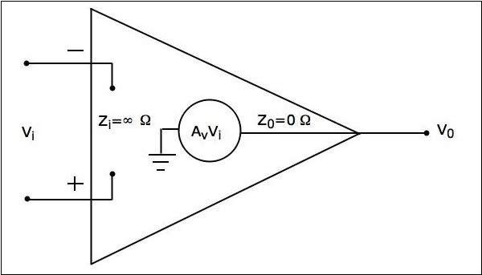
Ideal Op -Amp
Theoretical, non exist in practical
Equivalent Circuit
11

Slide 12
Characteristics of an Ideal -Op-Amp
Input impedance Z_{i}=∞Ω
Output impedance Z₀=0Ω
Open loop voltage gain Av=∞
If (the differential) input voltage V_{i}=0V, then the output voltage will be V₀=0V
Bandwidth is infinity. It means, an ideal op-amp will amplify the signals of any frequency without any attenuation.
Common Mode Rejection Ratio (CMRR) is infinity.
Slew Rate (SR) is infinity. It means, the ideal op-amp will produce a change in the output instantly in response to an input step voltage.
12

Slide 13
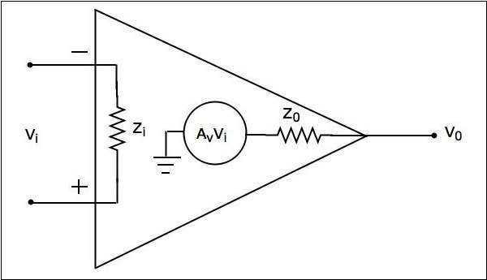
Practical Op -Amp
Non – Ideal Case, imperfections during manufacturing
Equivalent Circuit.
13

Slide 14
Characteristics of Practical Op -Amp
Input impedance, Z_{i} in the order of Mega ohms.
Output impedance, Z₀ in the order of few ohms..
Open loop voltage gain, A_{v} will be high.
When you choose a practical op-amp, you should check whether it satisfies the following conditions −
Input impedance, Zi should be as high as possible.
Output impedance, Z₀ should be as low as possible.
Open loop voltage gain, Av should be as high as possible.
14

Slide 15
Cont…
Output offset voltage should be as low as possible.
The operating Bandwidth should be as high as possible.
CMRR should be as high as possible.
Slew rate should be as high as possible.
15

Slide 16
Op-Amp Other Functions & Applications
Arithmetic Circuits
Differentiator & Integrator
Electrical quantity converters (V to I & I to V)
Comparators
Log & Anti-Log Amplifiers
Rectifiers
Clippers
Clampers
Active Filters
Sinusoidal Oscillators
Waveform Generators

Slide 17
Advantages & Disadvantages
Advantages
  Smaller Size
  Reduced Cost
  Simple designs without much discrete elements
Disadvantages
  Requires dual power supply
  Suits much in low power applications only

